Slide 1
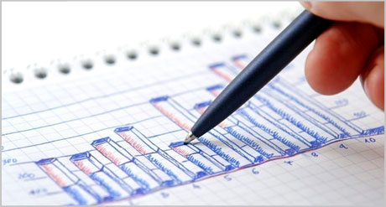
Human-Centered Data Visualization
Aaron D. Hoffman
ahoffman@stonefinch.com
@aaron_hoffman

Slide 2
Overview
Human-Centered Data Visualization
About Me
Agile Development
Lean Startup
Human-Centered Design
Data Analytics/Data Visualization “Big Data”
Iowa .NET User Group Leader
1 Million Cups Des Moines Organizer
Co-Founder StoneFinch
CTO Men’s Style Lab

Slide 3
Overview
Human-Centered Data Visualization
About You
Designers?
Developers?
Managers?
Developers:
Unit Testing?
Agile Development?
Pair Programming?

Slide 4
Overview
Human-Centered Data Visualization
What is Human-Centered Data Visualization?
The practice of using Human-Centered Design to help discover the correct Data Visualization.
Apply Agile Development practices to Design
Notes:
Also – User-Centered Design

Slide 5
Overview
Human-Centered Data Visualization
Agenda
Human-Centered Design
Desirably, Feasibility, Viability
Lean Startup, Agile Development
Data Visualization
Visualization Options, Comparison
Objectives define visualizations
Animations, Transitions

Slide 6
Human-Centered Design
Human-Centered Data Visualization
But First: Your Current Practice
Who…
Meets directly with end users prior to designing?
Creates multiple designs before development?
Meets directly with end users after release/UAT?
Test/Measures results of new feature?

Slide 7
Human-Centered Design
Human-Centered Data Visualization
Human-Centered Design
Works well with others
Lean Startup
Project Management
Human-Centered
Design
Agile
Development
Build, Measure, Learn
User Driven MVP
Validated Learning
Continuous Deployment
Desirability, Feasibility Viability
Iterative, User Tests, Learning
Process influences product
- People Focus -
Iterative Development
Continuous Learning
SOLID Methodology
Pair Programming, Unit Testing
Iterative Development
Notes:
Lean Startup, then Agile, then HCD

Slide 8
Human-Centered Design
Human-Centered Data Visualization
Benefits of Agile Development
Test Coverage, Self Documenting
Better Maintainability
Cost Effective Development
Summary: Better Code
Benefits of Human-Centered Design
Likable Software
Ease of Use, Intuitive
Balanced Approach to New Features
Summary: Better Software
Notes:
Agile: More Fun? Like working with people? --- Other benefits?
Balanced Approach to New Features – Parking Lot part of design?

Slide 9



Human-Centered Design
Human-Centered Data Visualization
Desirability
Feasibility
Viability
Notes:
Too Often start with Desirability, Viability, no Feasibility
Teleporter example, Product Guys – Okay – Sales Guy – Heck Yeah!, Feasibility… nope.

Slide 10
Human-Centered Design
Human-Centered Data Visualization
Process Influences Product
In-Person User Interviews
Ask Why/How not What
Discuss Existing Process not Desired Product
The design should support process not define process
User Driven Minimum Viable Product (MVP)
Small scope, well-defined, focused
After deployment, how will success be measured?

Slide 11
Human-Centered Design
Human-Centered Data Visualization
Note about Competition in Design
Which of these is better?
Compared to What?

Slide 12
Human-Centered Design
Human-Centered Data Visualization
Note about Competition in Design
Which of these is better?
“All designs are equally important. Reinforce the design chosen.” Bill Buxton

Slide 13
Human-Centered Design
Human-Centered Data Visualization
Standup Meetings – Daily
What did you do yesterday?
What do you plan to do today?
Do you have any roadblocks?
Validated Learning – Each Sprint
What did we know when we started?
What have we learned?
How does that change what we knew?
“I don’t know.”
A perfectly acceptable answer
An unacceptable solution

Slide 14


Human-Centered Design
Human-Centered Data Visualization
Think Iteratively not Incrementally
Iteratively
Incrementally

Slide 15
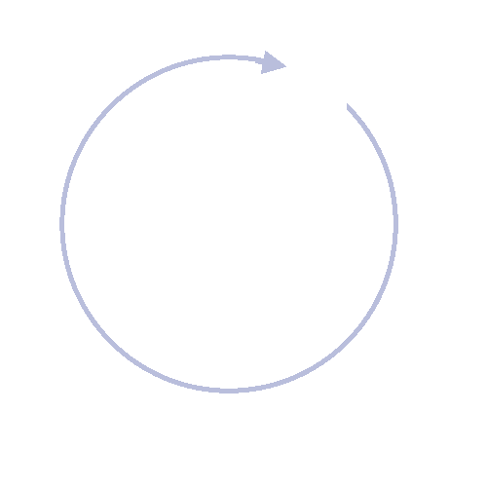
Human-Centered Design
Human-Centered Data Visualization
Interview
In-Person
Focus on Process
Learn
Review Data
Test Assumptions
Design
Desirability, Feasibility, Viability
Competition
Open Honest Review
Measure
In-Person
Big Data
Measure Success
Build
Pair Programming
Unit Testing
Plan to Refactor
Deploy
Continuous
Small Focused Releases

Slide 16
Data Visualization
Human-Centered Data Visualization
Data Visualization
“Goal is to Communicate information clearly and effectively through graphical means.”
“Both aesthetic form and functionality need to go hand in hand.”
Easier to process images, than plain text
Plain Text is Linear; Images are Parallel

Slide 17
Data Visualization
Human-Centered Data Visualization
Overall Guidelines
Clearly defined question that you are trying to answer.
Keep it simple, easy to understand (efficiency)
Focus users attention, complexity loses focus
Be accurate, not misleading
Know your medium (screen, paper, etc.)
The medium is part of the visualization

Slide 18
Data Visualization
Human-Centered Data Visualization
Don’ts
Rule of “Too much” – Just because you can, doesn’t mean you should
Too much Color, competing for focus
Too much Data, too complex

Slide 19
Data Visualization
Human-Centered Data Visualization
And now some examples….
Next slide:
Given 2 seconds
Find the highest value
Don’t yell it out!

Slide 20
Data Visualization
Human-Centered Data Visualization
Average Annual Rainfall per Year in Inches
City | Inches of Rain
Atlanta, GA | 40.59
Boston, MA | 42.53
Chicago, IL | 36.27
Dallas-Ft. Worth, TX | 34.73
Des Moines, IA | 34.72
Detroit, MI | 32.89
Houston, TX | 47.84
Kansas City, MO | 37.98
Los Angeles, CA | 13.15
Miami, FL | 58.53
Minneapolis–St. Paul, MN | 29.41
New York, NY | 49.69
Omaha, NE | 30.22
Philadelphia, PA | 42.05
Phoenix, AZ | 8.29
San Diego, CA | 10.77
San Francisco, CA | 20.11
Seattle-Tacoma, WA | 37.07
St. Louis, MO | 38.75
Washington, D.C. | 39.35

Slide 21
Data Visualization
Human-Centered Data Visualization
Previous Slide:
What is the context of the data?
Highest Value?
Lowest Value?
Average Range?
Confidence level in answers?
What else did you see?
Notes:
Context could define what “highest” means

Slide 22
Data Visualization
Human-Centered Data Visualization
Same task, different visualization
Next slide:
Given 2 seconds
Find the highest value

Slide 23
Data Visualization
Human-Centered Data Visualization

Slide 24
Data Visualization
Human-Centered Data Visualization
Same Questions
Previous Slide:
Highest Value?
Lowest Value?
Average Range?
Confidence level in answers?

Slide 25
Data Visualization
Human-Centered Data Visualization
Again, same task, different visualization
Next slide:
Given 2 seconds
Find the highest value

Slide 26
Data Visualization
Human-Centered Data Visualization

Slide 27
Data Visualization
Human-Centered Data Visualization
Again, Same Questions
Previous Slide:
Highest Value?
Lowest Value?
Average Range?
Confidence level in answers?

Slide 28
Data Visualization
Human-Centered Data Visualization
Our Question:
“What City has the highest average annual rainfall?”
What did we do to better answer our question; the objective of our visualization?
Added a visualization to represent each value
Sorted the data to better answer the question
Sort focuses data, makes it easier to understand

Slide 29
Data Visualization
Human-Centered Data Visualization
Bar chart not always appropriate/necessary
Next slide:
Given 2 seconds
Find the average rainfall for Houston, TX

Slide 30
Data Visualization
Human-Centered Data Visualization

Slide 31
Data Visualization
Human-Centered Data Visualization
Previous Slide:
Not as easy….

Slide 32
Data Visualization
Human-Centered Data Visualization
Same Task, different visualization
Next slide:
Given 2 seconds
Find the average rainfall for Houston, TX

Slide 33
Data Visualization
Human-Centered Data Visualization
Average Rainfall per Year in Inches
City | Inches of Rain
Atlanta, GA | 40.59
Boston, MA | 42.53
Chicago, IL | 36.27
Dallas-Ft. Worth, TX | 34.73
Des Moines, IA | 34.72
Detroit, MI | 32.89
Houston, TX | 47.84
Kansas City, MO | 37.98
Los Angeles, CA | 13.15
Miami, FL | 58.53
Minneapolis–St. Paul, MN | 29.41
New York, NY | 49.69
Omaha, NE | 30.22
Philadelphia, PA | 42.05
Phoenix, AZ | 8.29
San Diego, CA | 10.77
San Francisco, CA | 20.11
Seattle-Tacoma, WA | 37.07
St. Louis, MO | 38.75
Washington, D.C. | 39.35

Slide 34
Data Visualization
Human-Centered Data Visualization
Previous Slide:
The question you are trying to answer should influence your visual

Slide 35
Data Visualization
Human-Centered Data Visualization
Next Slide:
How can we better display this data?

Slide 36
Data Visualization
Human-Centered Data Visualization
Average Temperature in Degrees Fahrenheit by City and Month
City | Jan | Apr | Jul | Oct
Atlanta, GA | 42.7 | 61.6 | 80.0 | 62.8
Boston, MA | 29.3 | 48.3 | 73.9 | 54.1
Chicago, IL | 22.0 | 47.8 | 73.3 | 52.1
Dallas-Ft. Worth, TX | 44.1 | 65.0 | 85.0 | 67.2
Des Moines, IA | 20.4 | 50.6 | 76.1 | 52.8
Detroit, MI | 24.5 | 48.1 | 73.5 | 51.9
Houston, TX | 51.8 | 68.5 | 83.6 | 70.4
Kansas City, MO | 26.9 | 54.4 | 78.5 | 56.8
Los Angeles, CA | 57.1 | 60.8 | 69.3 | 66.9
Miami, FL | 68.1 | 75.7 | 83.7 | 78.8
Minneapolis–St. Paul, MN | 13.1 | 46.6 | 73.2 | 48.7
New York, NY | 32.1 | 52.5 | 76.5 | 56.6
Omaha, NE | 21.7 | 51.4 | 76.7 | 53.2
Philadelphia, PA | 32.3 | 53.1 | 77.6 | 57.2
Phoenix, AZ | 54.2 | 70.2 | 92.8 | 74.6
San Diego, CA | 57.8 | 62.6 | 70.9 | 67.6
San Francisco, CA | 49.4 | 56.2 | 62.8 | 61.0
Seattle-Tacoma, WA | 40.9 | 50.2 | 65.3 | 52.7
St. Louis, MO | 29.6 | 56.6 | 80.2 | 58.3
Washington, D.C. | 34.9 | 56.1 | 79.2 | 58.8

Slide 37
Data Visualization
Human-Centered Data Visualization
Previous Slide:
Was your first thought:
“What question are we trying to answer?”

Slide 38
Data Visualization
Human-Centered Data Visualization
Next Slide:
Given the Question:
“Which city has the largest difference in average temperature throughout the year?”
How should we display the data?

Slide 39
Data Visualization
Human-Centered Data Visualization
Average Temperature in Degrees Fahrenheit by City and Month
City | Jan | Apr | Jul | Oct
Atlanta, GA | 42.7 | 61.6 | 80.0 | 62.8
Boston, MA | 29.3 | 48.3 | 73.9 | 54.1
Chicago, IL | 22.0 | 47.8 | 73.3 | 52.1
Dallas-Ft. Worth, TX | 44.1 | 65.0 | 85.0 | 67.2
Des Moines, IA | 20.4 | 50.6 | 76.1 | 52.8
Detroit, MI | 24.5 | 48.1 | 73.5 | 51.9
Houston, TX | 51.8 | 68.5 | 83.6 | 70.4
Kansas City, MO | 26.9 | 54.4 | 78.5 | 56.8
Los Angeles, CA | 57.1 | 60.8 | 69.3 | 66.9
Miami, FL | 68.1 | 75.7 | 83.7 | 78.8
Minneapolis–St. Paul, MN | 13.1 | 46.6 | 73.2 | 48.7
New York, NY | 32.1 | 52.5 | 76.5 | 56.6
Omaha, NE | 21.7 | 51.4 | 76.7 | 53.2
Philadelphia, PA | 32.3 | 53.1 | 77.6 | 57.2
Phoenix, AZ | 54.2 | 70.2 | 92.8 | 74.6
San Diego, CA | 57.8 | 62.6 | 70.9 | 67.6
San Francisco, CA | 49.4 | 56.2 | 62.8 | 61.0
Seattle-Tacoma, WA | 40.9 | 50.2 | 65.3 | 52.7
St. Louis, MO | 29.6 | 56.6 | 80.2 | 58.3
Washington, D.C. | 34.9 | 56.1 | 79.2 | 58.8

Slide 40
Data Visualization
Human-Centered Data Visualization
Question:
“Which city has the largest difference in average temperature throughout the year?”
Previous Slide:
Can we answer this question accurately?
Next Slide:
Given what we know, an option:

Slide 41
Data Visualization
Human-Centered Data Visualization
Average Temperature in Degrees Fahrenheit by City and Month

Slide 42
Data Visualization
Human-Centered Data Visualization
Previous Slide:
Good things?
Bad things?
What happened to all the cities?
Color Scheme?
Next Slide:
Update Color, Sort Order

Slide 43
Data Visualization
Human-Centered Data Visualization
Average Temperature in Degrees Fahrenheit by City and Month

Slide 44
Data Visualization
Human-Centered Data Visualization
Previous Slide:
Colors are less distracting
Sort order helps us answer the question.
Too much data?
Next Slide:
If we can sort on the correct value, why don’t we just display that value?
Color influence when there is only one color.

Slide 45
Data Visualization
Human-Centered Data Visualization

Slide 46
Data Visualization
Human-Centered Data Visualization

Slide 47
Data Visualization
Human-Centered Data Visualization
New Data, New Question
“How do temperatures differ between cities throughout the year?”
Comparing multiple cities
Multiple data points per city, sequential data
Chart Type: Line Chart

Slide 48
Data Visualization
Human-Centered Data Visualization
Average Temperature in Degrees Fahrenheit by City and Month
City | Jan | Feb | Mar | Apr | May | Jun | Jul | Aug | Sep | Oct | Nov | Dec
Des Moines, IA | 19.4 | 24.7 | 37.3 | 50.9 | 62.3 | 71.8 | 76.6 | 73.9 | 65.1 | 53.5 | 39.0 | 24.4
Phoenix, AZ | 53.6 | 57.7 | 62.2 | 69.9 | 78.8 | 88.2 | 93.5 | 91.5 | 85.6 | 74.5 | 61.9 | 54.1
San Francisco, CA | 51.1 | 54.4 | 54.9 | 56 | 56.6 | 58.4 | 59.1 | 60.1 | 62.3 | 62 | 57.2 | 51.7
Anchorage, AK | 14.9 | 18.7 | 25.7 | 35.8 | 46.6 | 54.4 | 58.4 | 56.3 | 48.4 | 34.6 | 21.2 | 16.3

Slide 49
Data Visualization
Human-Centered Data Visualization
Average Temperature in Degrees Fahrenheit by City and Month

Slide 50
Data Visualization
Human-Centered Data Visualization
Previous Slide:
Color difference okay here, separates data
Does this need to be printed in black and white?
If line series overlap, should point marks be used?

Slide 51
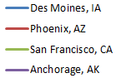
Data Visualization
Human-Centered Data Visualization
Average Temperature in Degrees Fahrenheit by City and Month
City | Jan | Feb | Mar | Apr | May | Jun | Jul | Aug | Sep | Oct | Nov | Dec
 | 19.4 | 24.7 | 37.3 | 50.9 | 62.3 | 71.8 | 76.6 | 73.9 | 65.1 | 53.5 | 39.0 | 24.4
 | 53.6 | 57.7 | 62.2 | 69.9 | 78.8 | 88.2 | 93.5 | 91.5 | 85.6 | 74.5 | 61.9 | 54.1
 | 51.1 | 54.4 | 54.9 | 56 | 56.6 | 58.4 | 59.1 | 60.1 | 62.3 | 62 | 57.2 | 51.7
 | 14.9 | 18.7 | 25.7 | 35.8 | 46.6 | 54.4 | 58.4 | 56.3 | 48.4 | 34.6 | 21.2 | 16.3

Slide 52
Data Visualization
Human-Centered Data Visualization
New Data, New Question
“How does precipitation differ throughout the United States?”
There is not a single point of data to answer to this question (min, max, average, etc.), it is a comparison, we are investigating the data.
Chart Type: Heat Map

Slide 53
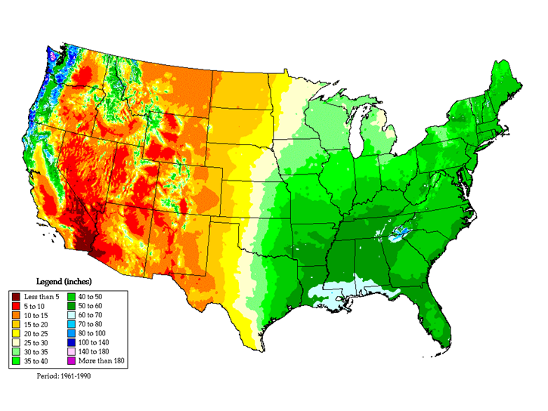
Data Visualization
Human-Centered Data Visualization
Average Annual Precipitation (Rain)

Slide 54
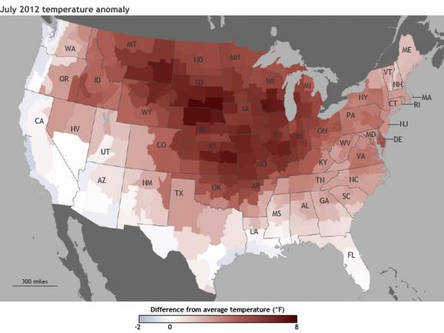
Data Visualization
Human-Centered Data Visualization

Slide 55
Data Visualization
Human-Centered Data Visualization
Regional Language Differences
“What kind of pop do you guys want?”
“What kind of coke y’all want?”

Slide 56
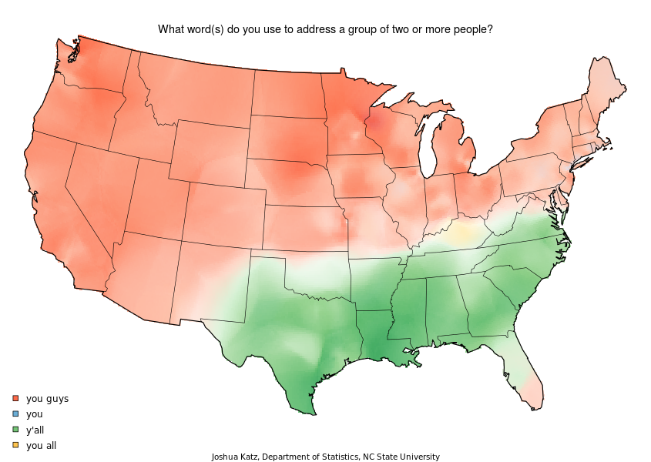
Data Visualization
Human-Centered Data Visualization

Slide 57
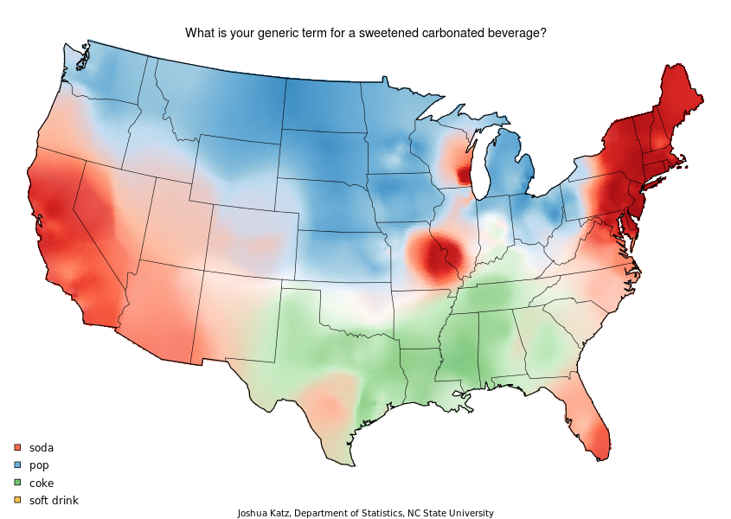
Data Visualization
Human-Centered Data Visualization

Slide 58
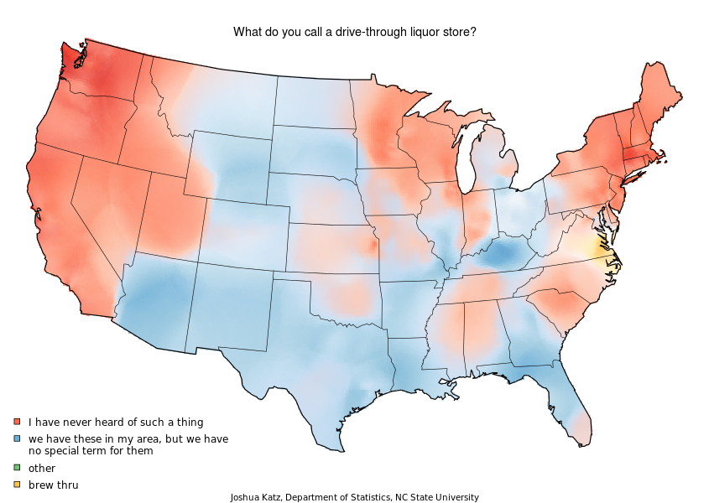
Data Visualization
Human-Centered Data Visualization

Slide 59
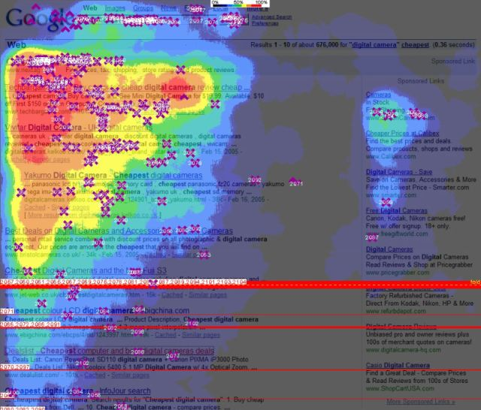
Data Visualization
Human-Centered Data Visualization

Slide 60
Data Visualization
Human-Centered Data Visualization
New Data, New Question
What if you need to chart three separate values per category/label?
Chart Type: Bubble Chart

Slide 61
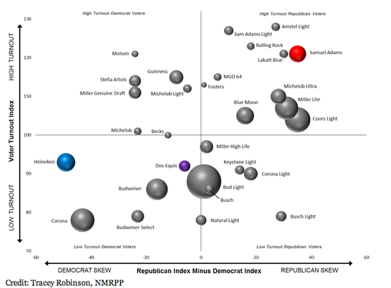
Data Visualization
Human-Centered Data Visualization
Beer Preference by Political Party, Voter Turnout and Number of Drinkers

Slide 62
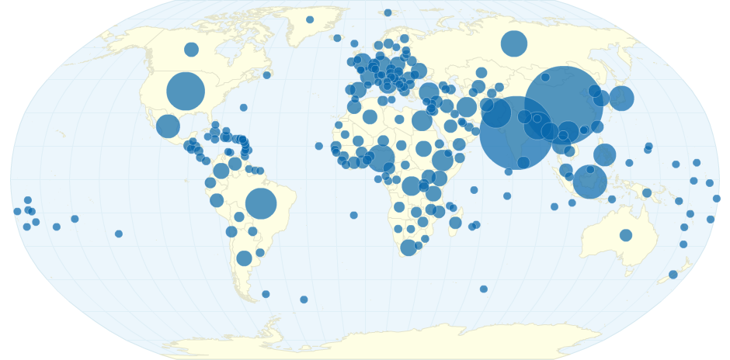
Data Visualization
Human-Centered Data Visualization
Population By Country

Slide 63
Data Visualization
Human-Centered Data Visualization
Issues with bubble charts
Overlapping data points
Hard to compare bubble size to one another

Slide 64

Data Visualization
Human-Centered Data Visualization
Which white circle is bigger?

Slide 65

Data Visualization
Human-Centered Data Visualization
Which white circle is bigger?

Slide 66
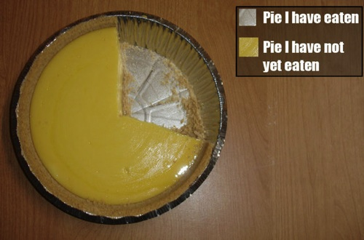
Data Visualization
Human-Centered Data Visualization
Pie Charts can have the same issue
Hard to compare slices to each other
Credit Dr. Tobias Komischke

Slide 67
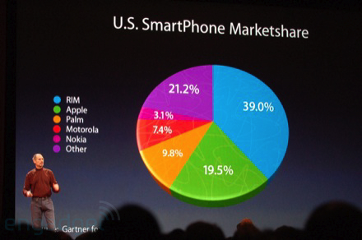
Data Visualization
Human-Centered Data Visualization
Marketing?

Slide 68
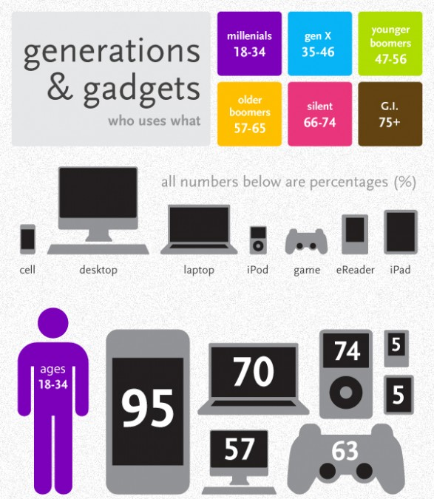
Data Visualization
Human-Centered Data Visualization

Slide 69
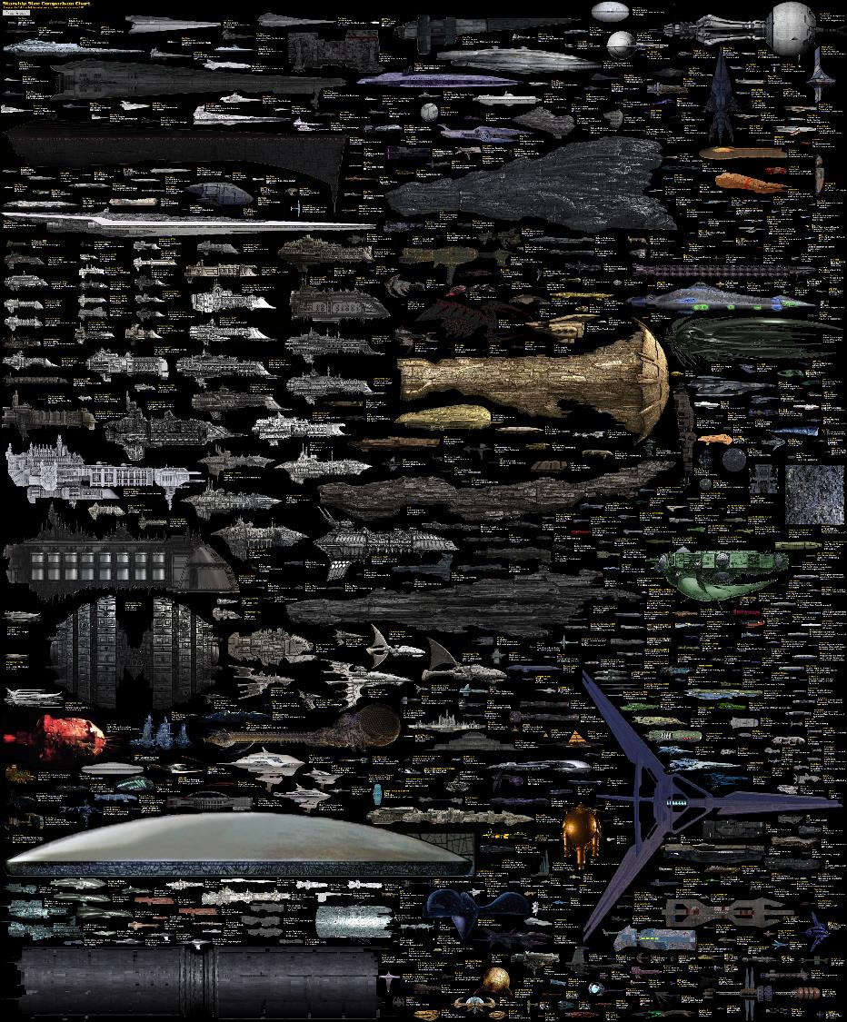
Data Visualization
Human-Centered Data Visualization
http://dirkloechel.deviantart.com/art/Size-Comparison-Science-Fiction-spaceships-398790051

Slide 70
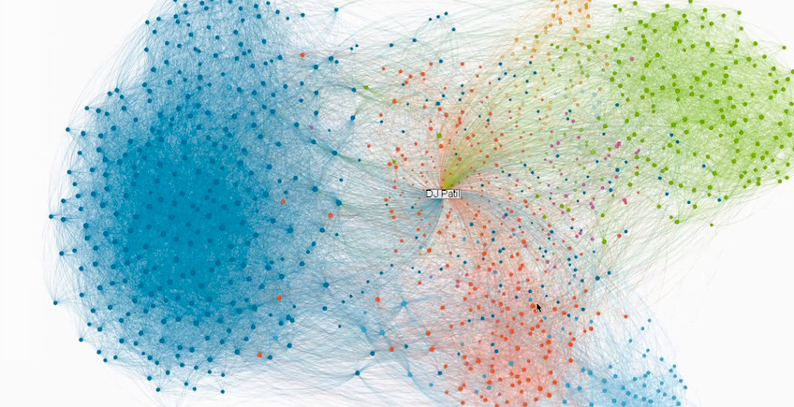
Data Visualization
Human-Centered Data Visualization
http://www.fastcodesign.com/1663098/infographic-of-the-day-linkedin-maps-big-shots-in-your-social-network

Slide 71
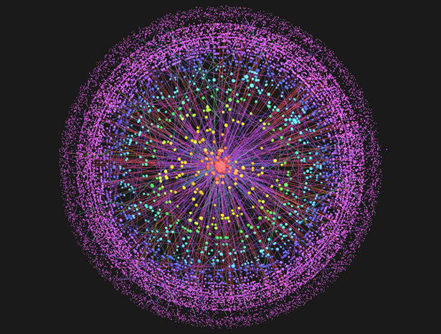
Data Visualization
Human-Centered Data Visualization
http://www.technologyreview.com/news/408104/mapping-the-internet/

Slide 72
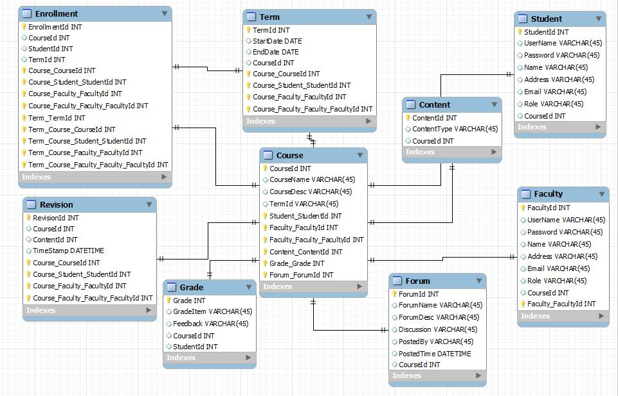
Data Visualization
Human-Centered Data Visualization
http://web.njit.edu/~vs252/Projects/Projects.htm

Slide 73
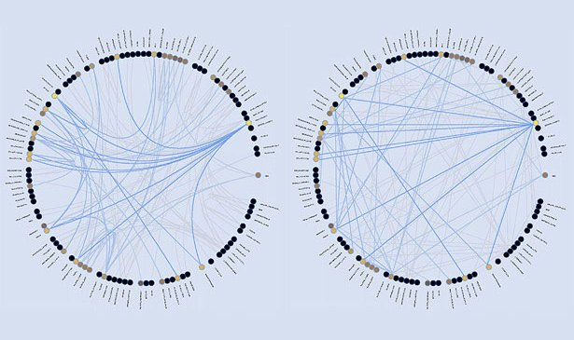
Data Visualization
Human-Centered Data Visualization
http://mkweb.bcgsc.ca/schemaball/?home

Slide 74
Data Visualization
Human-Centered Data Visualization
Animations/Transitions
When transitioning from one related data set to another, the transition between the data can also tell a story.
If you flash or blink from one to the other, that story can be lost.

Slide 75
Data Visualization
Human-Centered Data Visualization
Average Temperature in Degrees Fahrenheit by City and Month

Slide 76
Data Visualization
Human-Centered Data Visualization

Slide 77
Data Visualization
Human-Centered Data Visualization
Average Temperature in Degrees Fahrenheit by City and Month

Slide 78
Data Visualization
Human-Centered Data Visualization
The break between data sets causes a loss of context.
Harder to see the difference between the data.
Introduce a transition between the data, the entire story can be told.

Slide 79
Data Visualization
Human-Centered Data Visualization
Average Temperature in Degrees Fahrenheit by City and Month

Slide 80
Data Visualization
Human-Centered Data Visualization
Average Temperature in Degrees Fahrenheit by City and Month

Slide 81
Data Visualization
Human-Centered Data Visualization
Average Temperature in Degrees Fahrenheit by City and Month

Slide 82
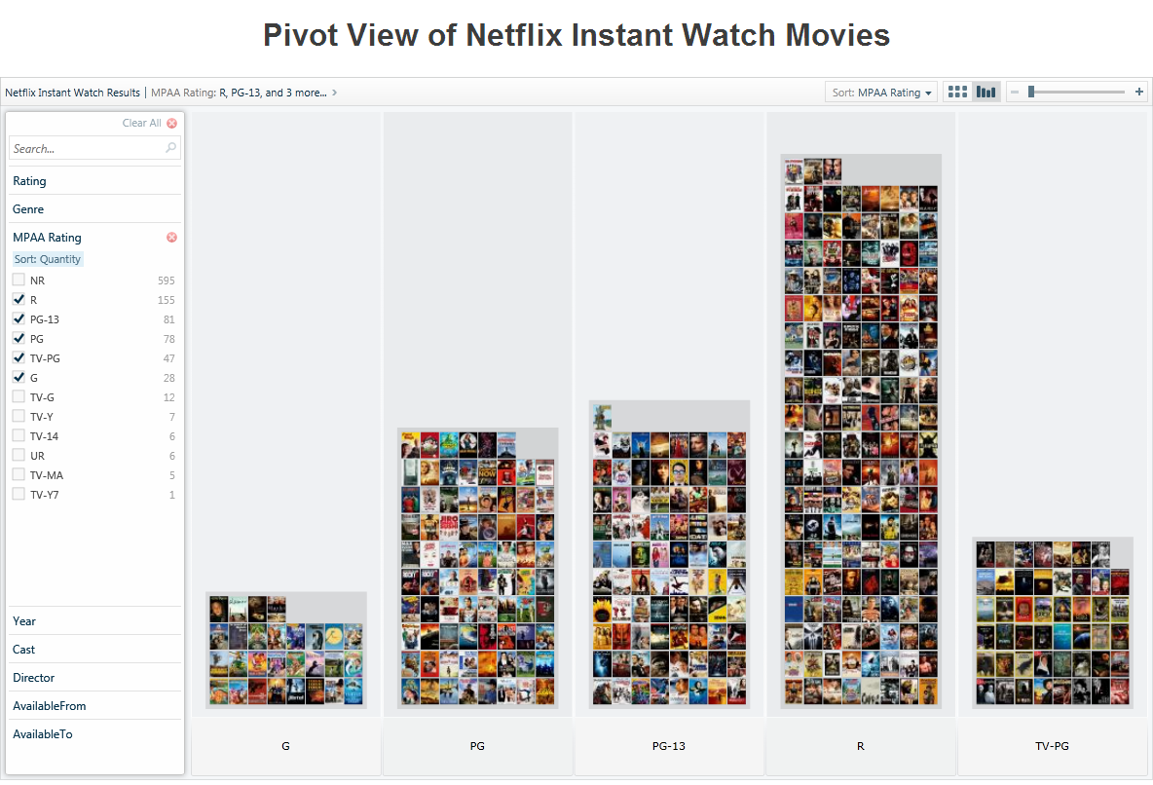
Data Visualization
Human-Centered Data Visualization
http://netflixpivot.cloudapp.net/

Slide 83
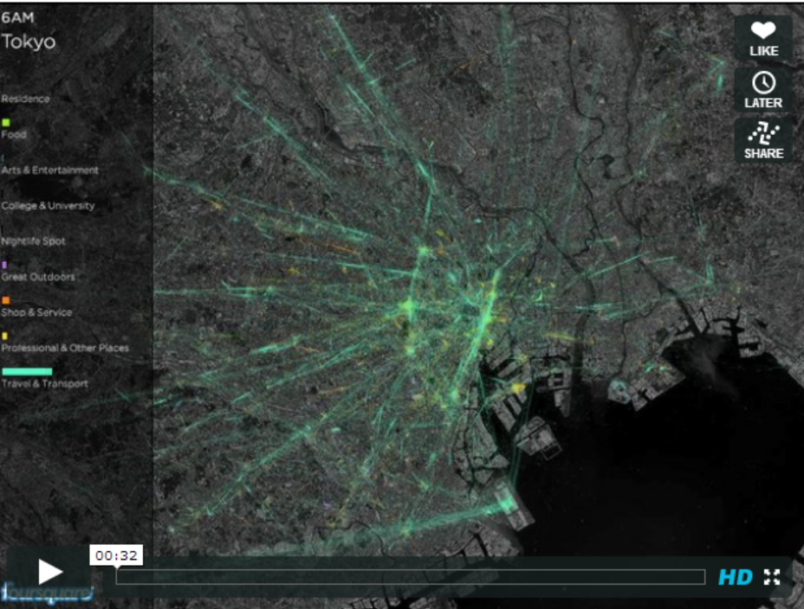
Data Visualization
Human-Centered Data Visualization
http://vimeo.com/75404940

Slide 84
The End
Human-Centered Data Visualization
Go make Visualizations!
Interview your users!
Have Competition in Design!
Measure your success!
Iterate!
Questions?

